Slide 1
Shopping Cart
Jeji Vedullapalli Venkatesh Javvaji

Slide 2
Contents
Introduction
Sample code
Demo

Slide 3
Introduction
Shopping cart is an online inventory
Contains variety of products to purchase
Requires log-in to purchase
Allows you to update your information
Can view your cart at anytime to keep track your items purchased

Slide 4
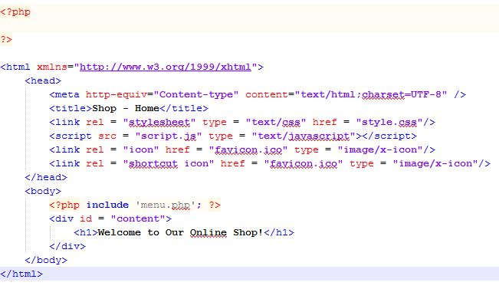
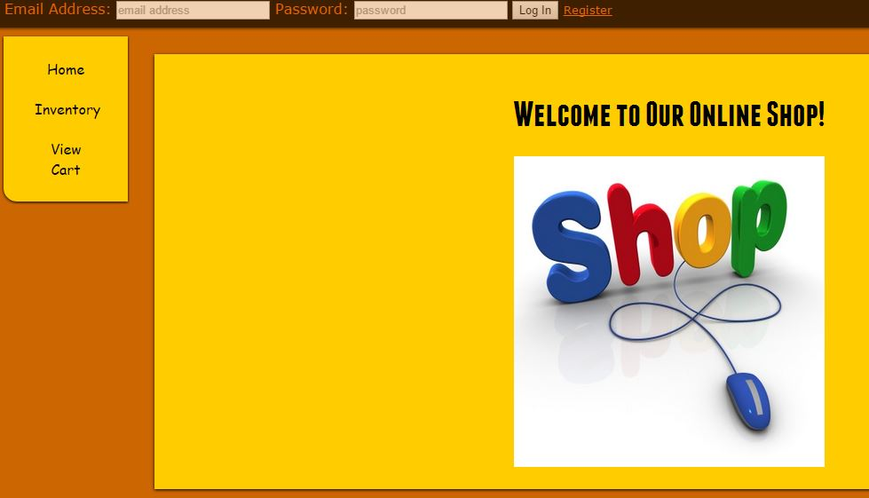
Sample Code (index.php)

Slide 5
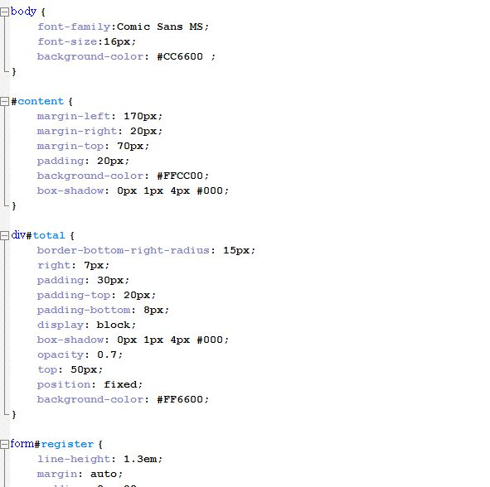
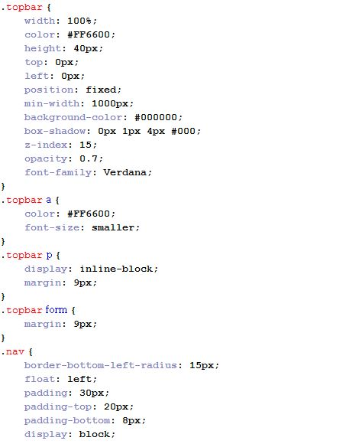
Sample Code (CSS)

Slide 6
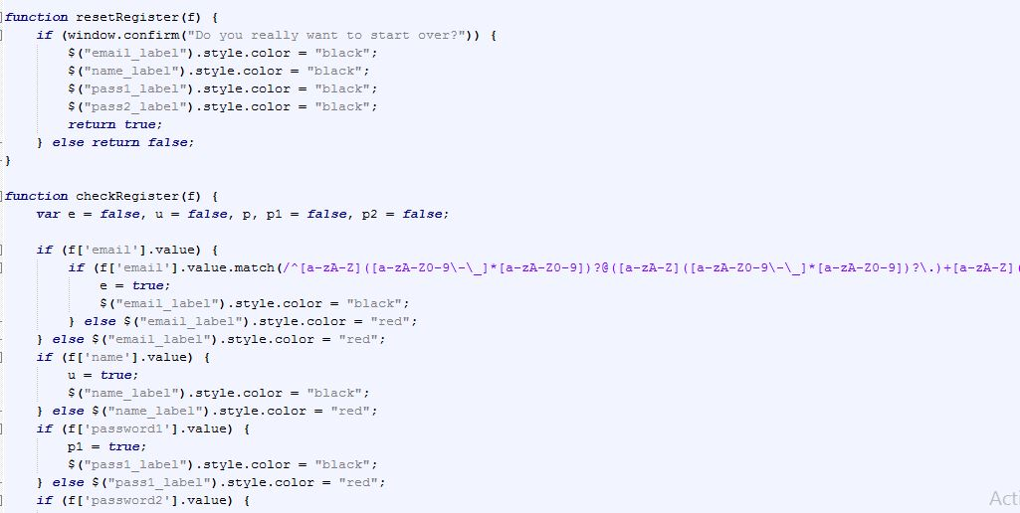
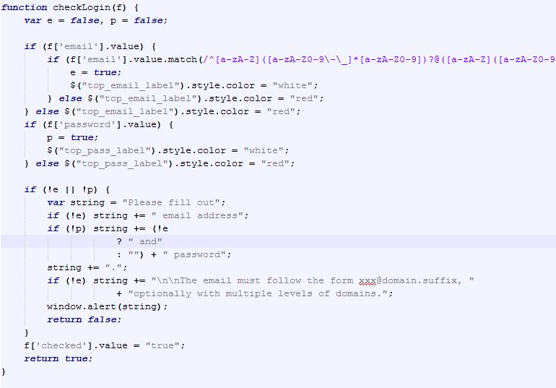
Sample Code (Java Script)

Slide 7
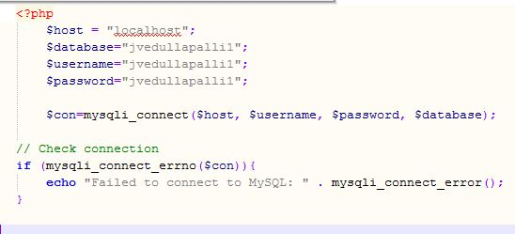
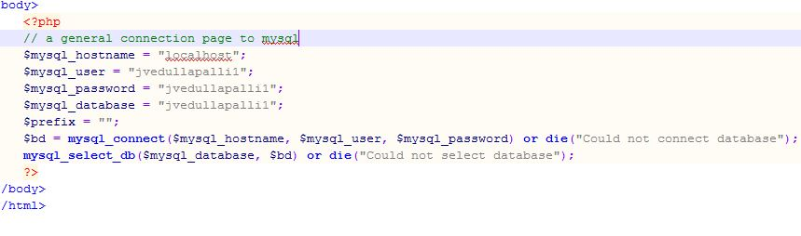
Sample Code (dbconnect.php)

Slide 8
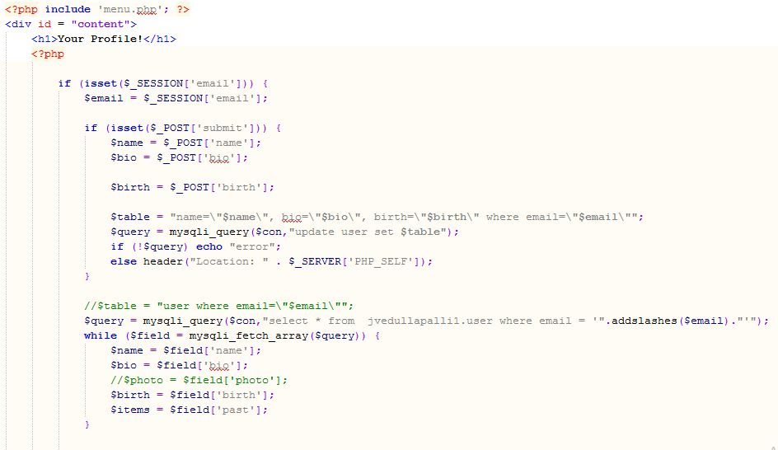
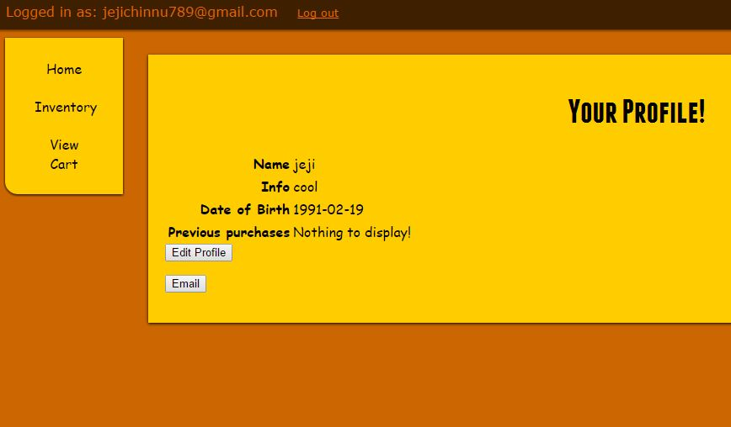
Sample Code (profile.php)

Slide 9
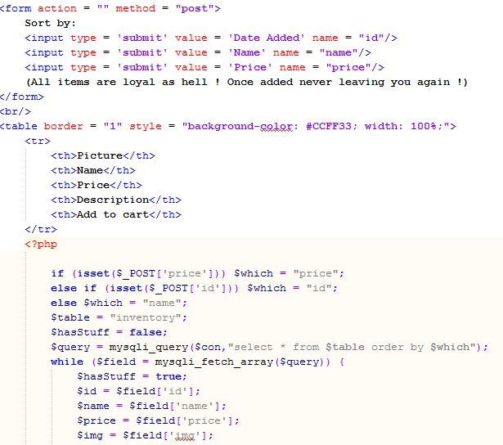
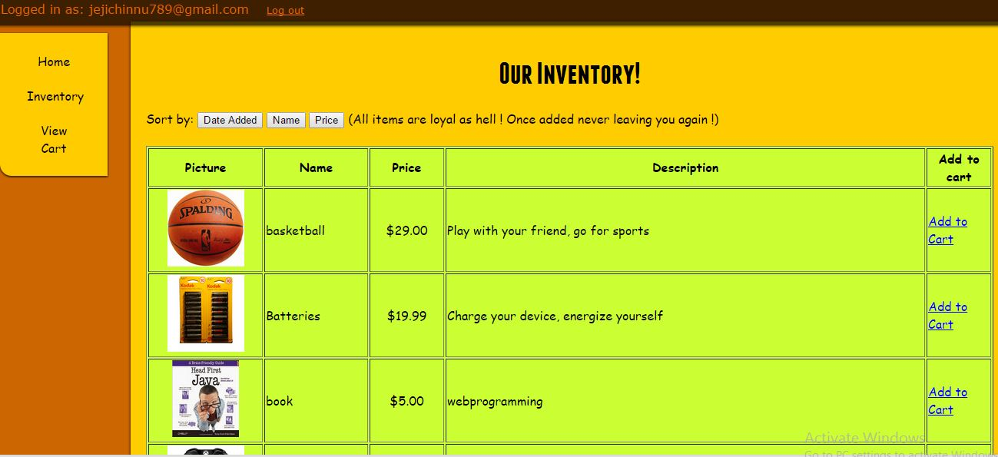
Sample Code (inventory.php)

Slide 10
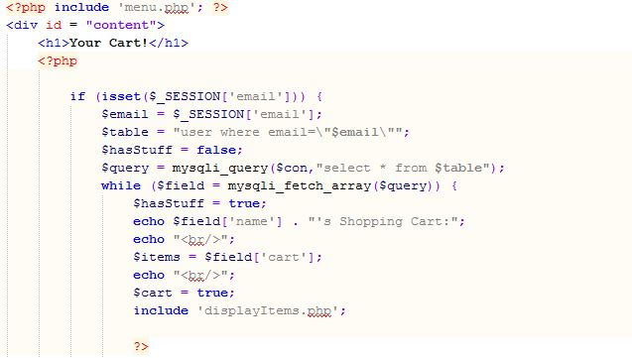
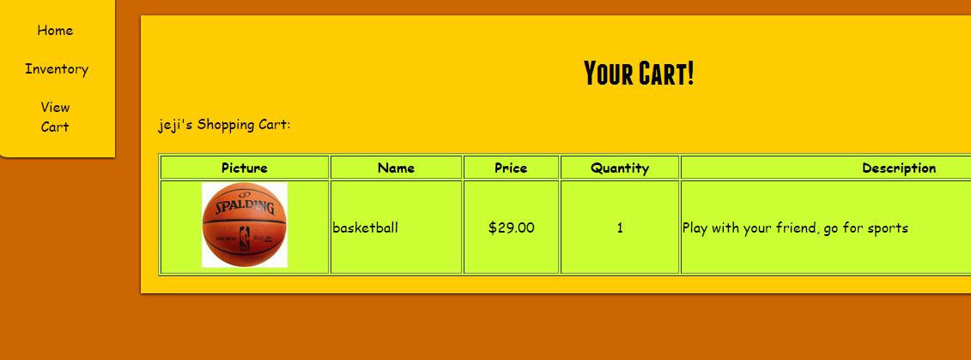
Sample Code (cart.php)

Slide 11
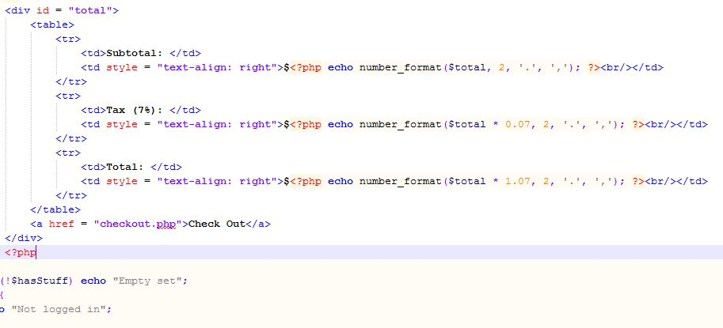
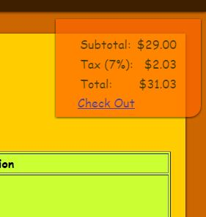
Sample Code (cart.php)

Slide 12
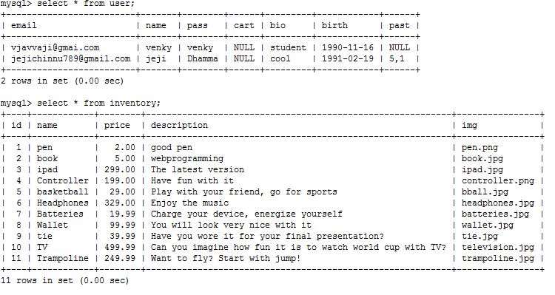
Sample Code (Database)

Slide 13
Demo…

Slide 14
Thank you !!

